Slide 1
All Recipes
By: Noor A, Alyssa S, Ava G

Slide 2
Week 5: MINI UPDATE #5

Slide 3
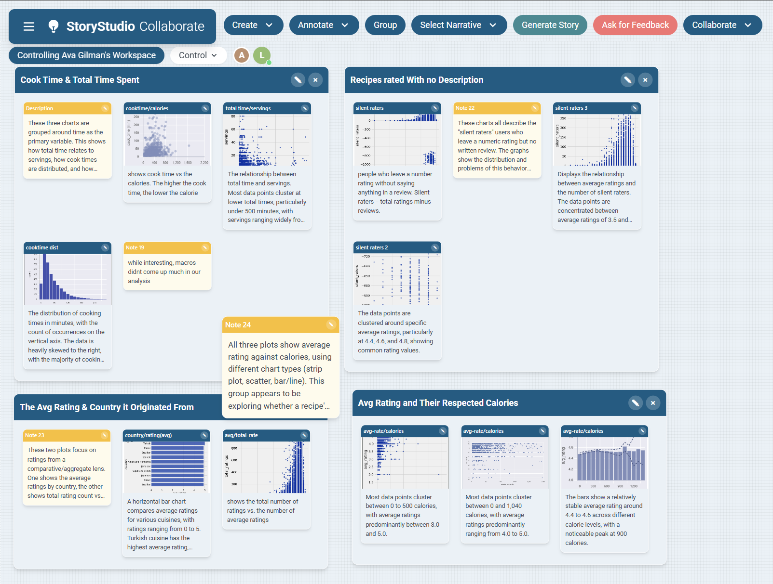
Storyboarding
When exploring recipes, cook time and calories share an inverse relationship, while most cooking happens under 500 minutes with widely varying serving sizes. Interestingly, many users leave silent ratings and numbers without any written review. This raises questions about engagement. Despite this, average ratings remain consistently high between 4.4 and 4.6 across all calorie levels and cuisines, suggesting that people generally enjoy the recipes they make regardless of where they originate or how indulgent they are.

Slide 4
Progress:
Alyssa: We created our first storyboard as a group after learning from class. Overall, I think we did a good job telling a story with all of the data plots that we have made via JupyterHub over the course of around five weeks. It was very cool to place each of our plots into groups to see which ones go together based off of our datasets. From that, we could tell a story about these graphs that we couldn’t before.
Ava: I agree with Alyssa. It was interesting to see which variables we focused on over these last few weeks, and which variables we didn’t analyze at all. We focused a lot on calories per serving, time (cook/prep/total), and ratings. Macros were largely ignored, as were countries somewhat. The ingredients variable was hard to analyze due to the sheer amount of data cleaning that would be necessary. The URL, author, and date published were ignored. I do wonder if the date or author could have been explored more.
Noor- I agree with Alyssa and Ava. I think we did a good job with gathering our data and making insights. Although, we struggled on the instructors expectations of the project, we worked together as a group and communicated with each other very effectively.

Slide 5
Feedback:
Alyssa: I’m glad that I was able to create a plot that almost perfectly matched with my data provided by my instructor the week before. For my other graph, I can see now that using a scatter plot was harder to see where the data plots actually were. For graphs like that, I will use a line plot so it is easier to see.
Ava: I’m still not sure what to do with the strange clump of outliers in the “silent raters” scatterplot I made last week.
Noor- This week, I got to practice making storyboards on story studio. It was fascinating to use real world examples and grouping them in story studio.

Slide 6
Week 4: MINI UPDATE #4

Slide 7
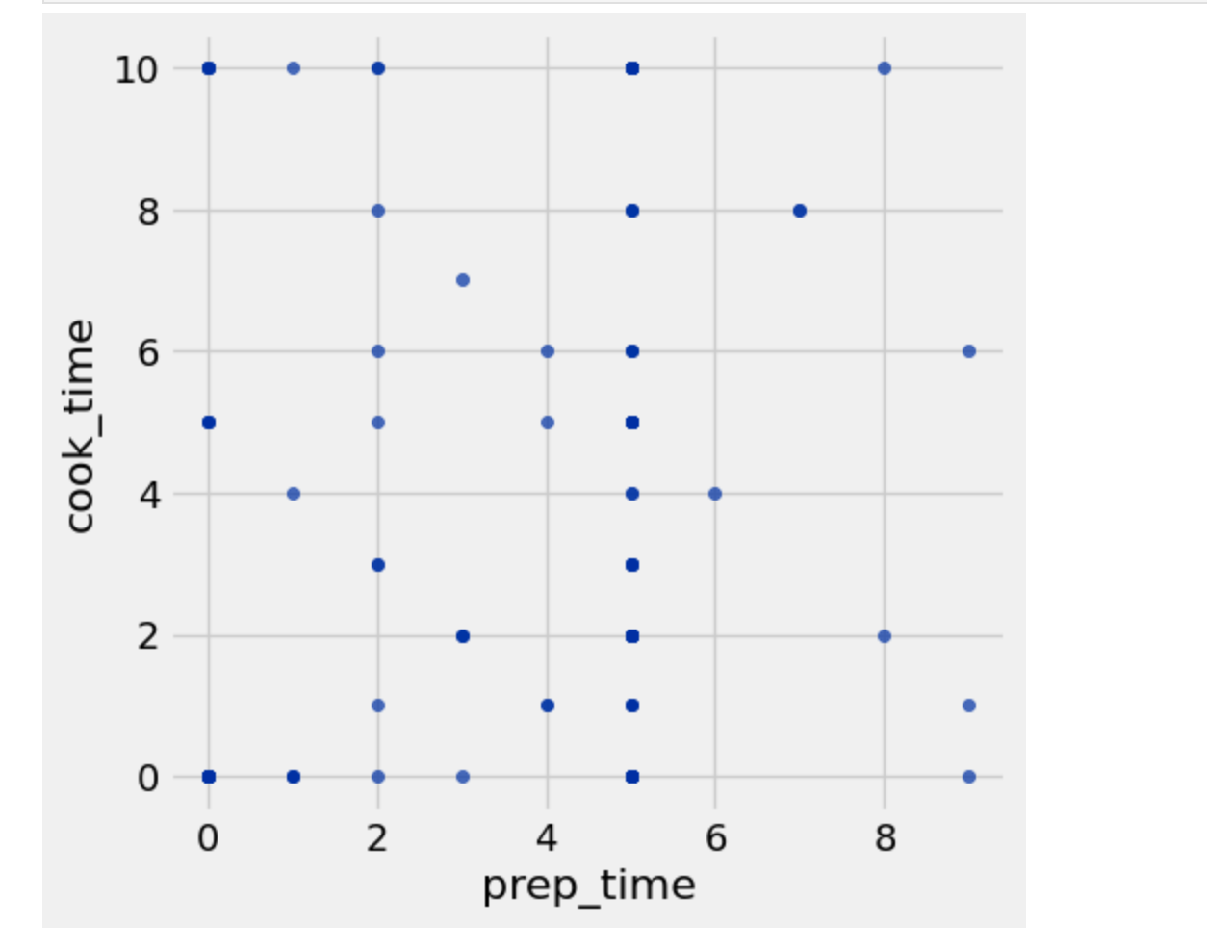
MINI UPDATE #4- Noor Abbasi
To reach my audience goals, this week I plan to find fast and convenient recipes from the recipes data that are easily accessible to college students and people who are looking for quick and easy recipes that have a cook time of less than 10 minutes and a prep time thats less than 10 minutes. I graphed a scatter plot that shows the cooking time and the prep time of preparing recipes. This graph shows the viewer that there are many different options of recipes to choose from that they can make to help them save time!

Slide 8
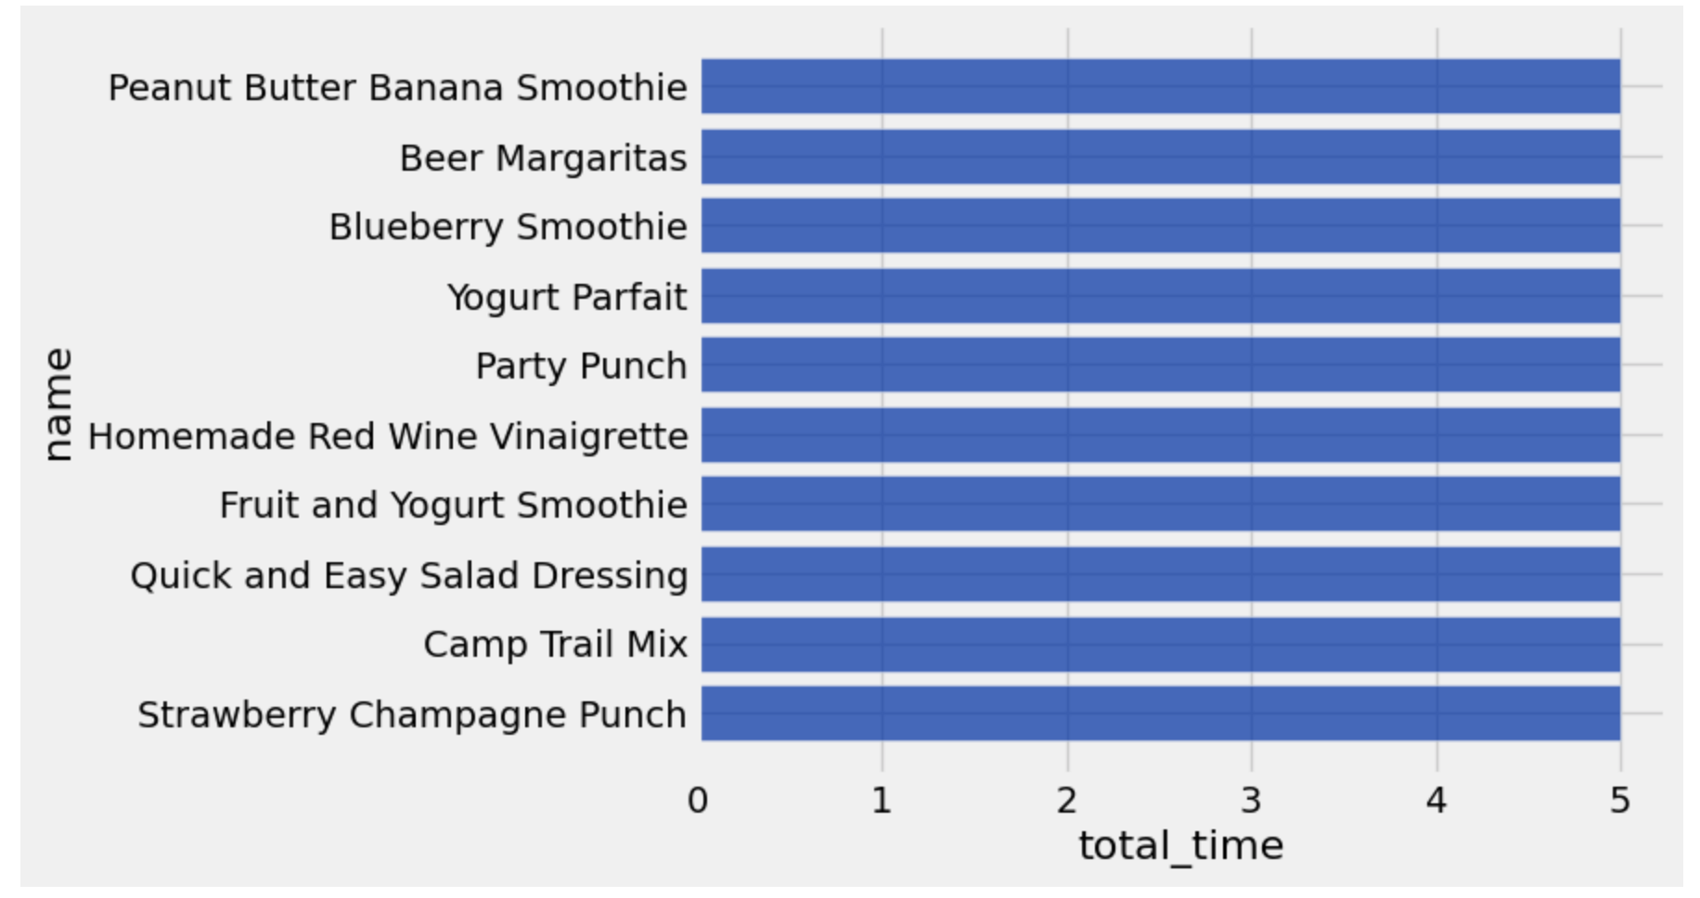
MINI UPDATE #4- Noor Abbasi
To find the fastest recipes in the recipes table, I used a barchart to display the top 10 recipes that take the 5 minutes or less to make. As you can see, most of them are either smoothie or drinks. Some are very nutritious and other are not. This data is very helpful to students or people who need quick and easy recipes by providing them with recipes that can be easily made in 5 minutes or less! Not only does it save time but also provides the nutrients one needs!

Slide 9
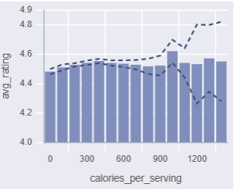
Alyssa S - Mini Update #4
Graph between calories and cook time
ANALYSIS: To better answer whether calorie count affects how a recipe is rated, recipes were grouped into 200-calorie bins and the mean rating with 95% confidence interval was calculated for each. The mean ratings across all bins falls between a narrow/slim range between 4.48 and 4.62, and every confidence interval overlaps with the others. This means there is no statistically meaningful difference in ratings between low- and high-calorie recipes. Calorie count alone does not predict how well a recipe is received.

Slide 10
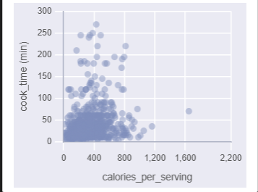
Alyssa S - Mini Update #4
Graph between calories and cook time
ANALYSIS: This scatter plot shows the relationship between calories per serving and cook time across all recipes. The vast majority cluster tightly under 600 calories and 60 minutes, confirming that most AllRecipes content is quick, moderate-calorie everyday cooking. A small number of recipes extend into higher calorie counts or longer cook times, forming a sparse right tail in both directions. The two dimensions do not move together strongly. A high-calorie recipe is not necessarily a long-cook one taking into consideration that they are influenced by different factors.

Slide 11
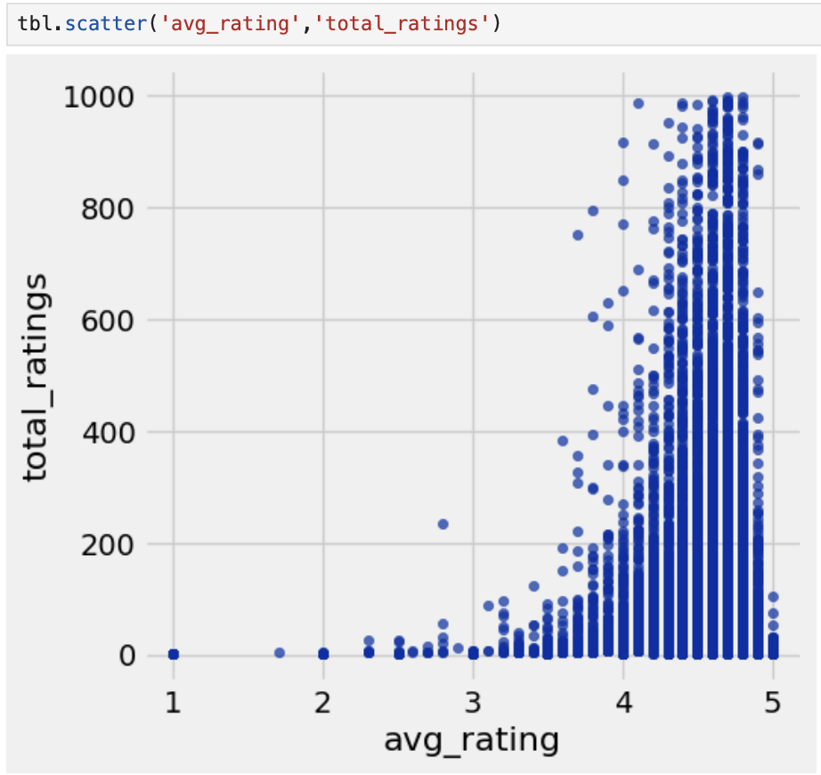
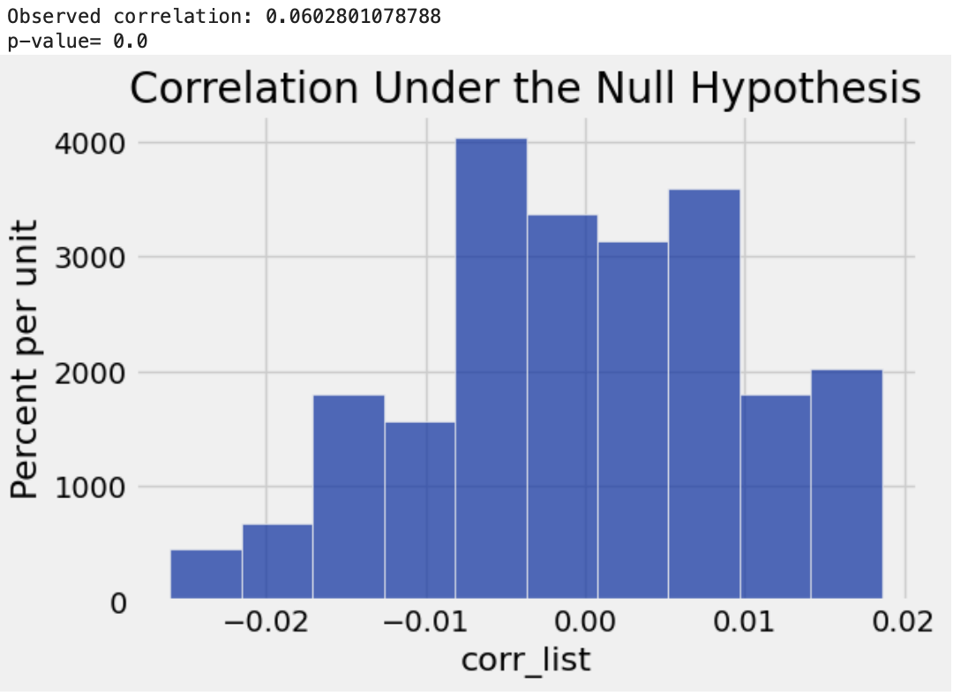
MINI UPDATE #4- Ava G
I used lab 12’s guide to analyze permutation of two continuous variables. I chose to analyze the average rating and total ratings. I made a scatterplot first, then found the observed correlation of 0.06 and found the p-value which is incredibly close to zero. This data shows that these two variables are highly correlated and we reject the null hypothesis. In other words, this means that as a recipe has more ratings logged, it’s more likely to have a higher average rating out of 5.

Slide 12
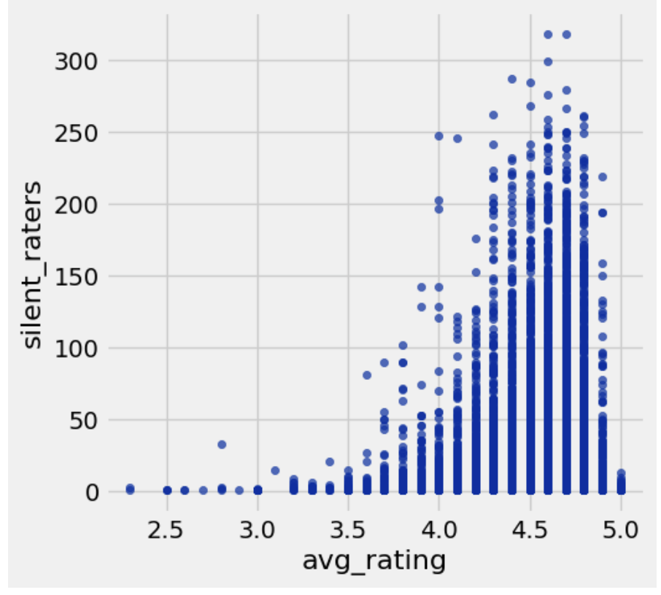
MINI UPDATE #4- Ava G
I noticed two different columns- total ratings and reviews. To my knowledge, ratings are when someone leaves a star out of 5, and reviews are when someone writes and posts something about the recipe beyond just a number. I created a column to represent the difference between these two variables, dubbed the “silent raters.” These are people who leave a number rating without saying anything in a review. Silent raters = total ratings minus reviews. The higher the silent raters, the more total ratings and the less reviews a recipe got. This scatterplot shows a trend between the variable silent ratings and the average rating of a recipe. I notice a correlation between the two variables. As the number of silent raters goes up, the score of rating for a recipe tends to increase. The opposite is also true. This makes sense, because if someone likes a recipe, they’ll give it some stars. But if someone hates a recipe, they have something to say about it, and are more likely to leave a review.

Slide 13
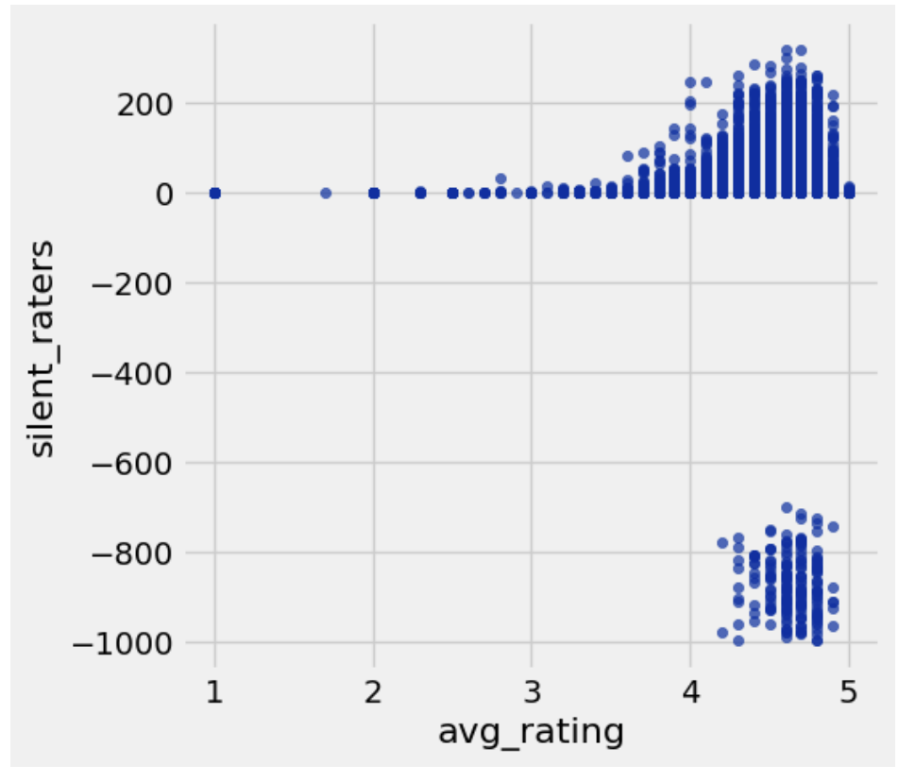
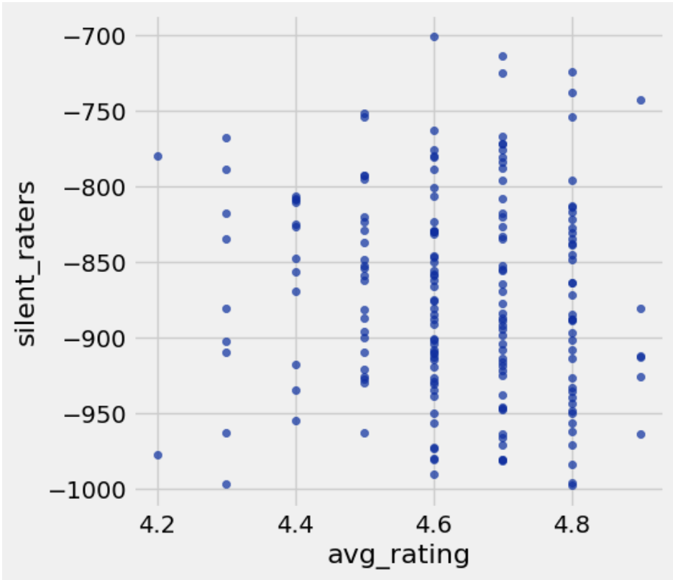
MINI UPDATE #4- Ava G
There was an issue with the “silent raters” variable. For the previous slide, I highlighted where silent raters was above zero. However, as pictured in the top graph, there were two “clumps” of data in the scatterplot. The top clump (from the previous slide) makes sense, but the bottom one doesnt. Why would a recipe have more reviews than ratings, let alone 700-1000 more? There are no data points of a recipe having 1-600 more reviews than ratings, which I find odd. Of these strange recipes from that second clump, they’re all rated an average of 4-5 stars. Why would anyone leave a review on a recipe and not give it a rating while they’re at it? Very strange.

Slide 14
Progress:
Noor- This week, I looked for different ways to display the prep, cook, and total time into graphs while also trying to find more methods into analyzing this data more efficiently. Next week, I plan to use my knowledge that I learned in class and attempt to incorporate into my work.
Alyssa- So far, I used the confidence interval that I’ve learned in class and tried to see how it works here including mean. I don’t know if I did it correct as I am still learning, but currently I think it has been helping with my overall analysis for both mini update graphs..
Ava- This week, I looked more into ratings and reviews. There were some interesting findings. I don’t know how to interpret some of them, but overall it was very interesting to dive into.

Slide 15
Feedback:
Noor- Looking at the feedback, I understand what I may have done incorrectly. Hopefully throughout the weeks, I can learn from my mistakes and improve my data analysis skills as well as trying new methods to graph my data.
Alyssa- I appreciates the feedback as it makes sense of how I can compare cook time and other variables that correlate with this mini update. I was still struggling to seeing if I did the confidence intervals and finding the mean correctly as I we did or if I needed to with the graph I used.
Ava- I agree its a good idea to highlight certain areas on graphs as “ideal” so the audience knows what to look for. As for the ingredients feedback, I was struggling to come up with a better way to represent the data. The example graph that was provided is new to me, but could be very useful to represent data such as ingredients.

Slide 16
Week 3: MINI UPDATE #3

Slide 17
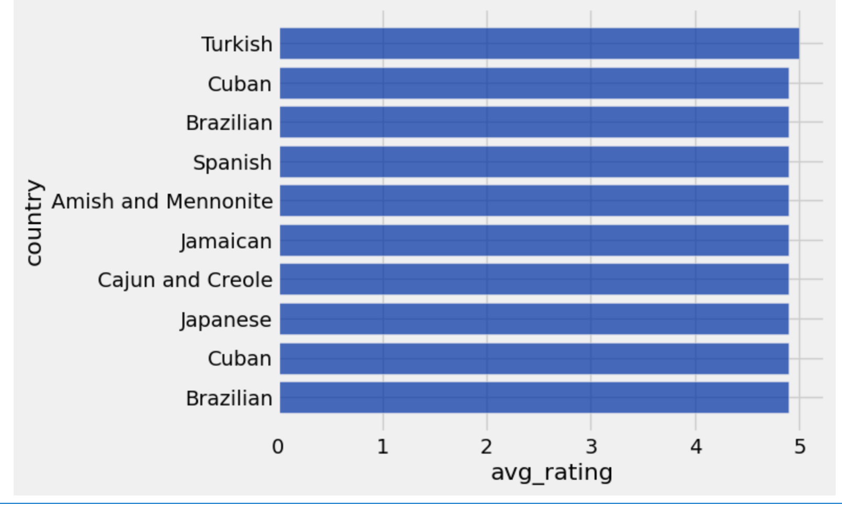
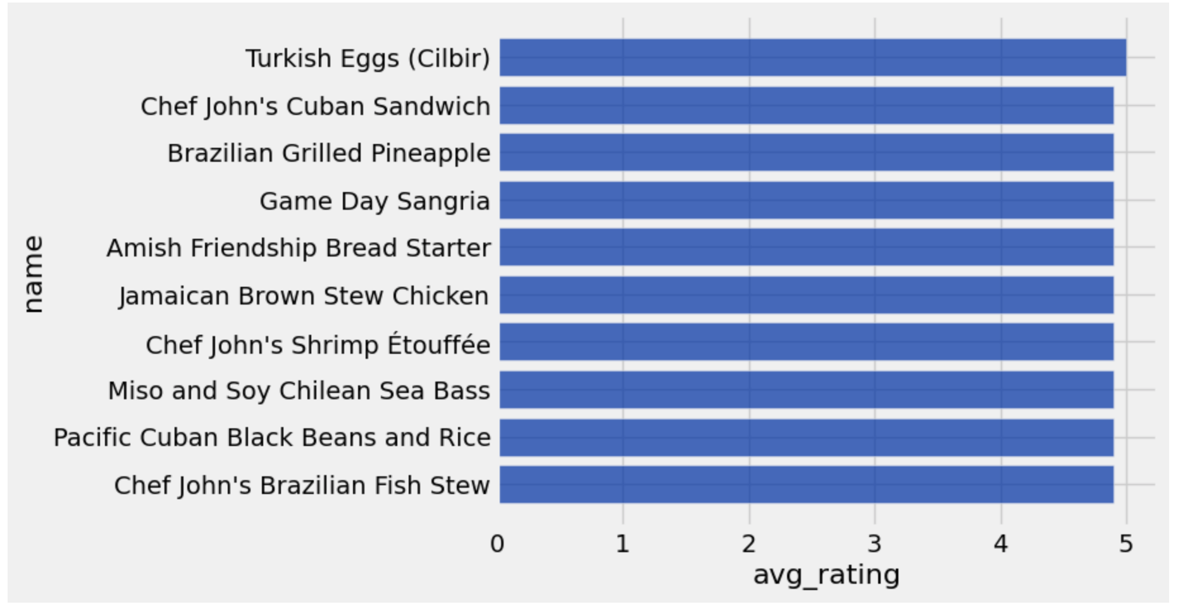
Noor Abbasi-MINI UPDATE #3
fig.1
This week, I have decided to focus on the cuisines data. I am going to analyze the first top 10 most popular in the cuisines data (similar to what I did in the recipes data)(Refer back to Week 2). I also included fig. 1 to display the countries that are also the most popular along with their recipes. I can see that Turkish Eggs are rated #1 and I also notice that Cuban and Brazilian dishes are the most popular among the top ten.
fig.2

Slide 18
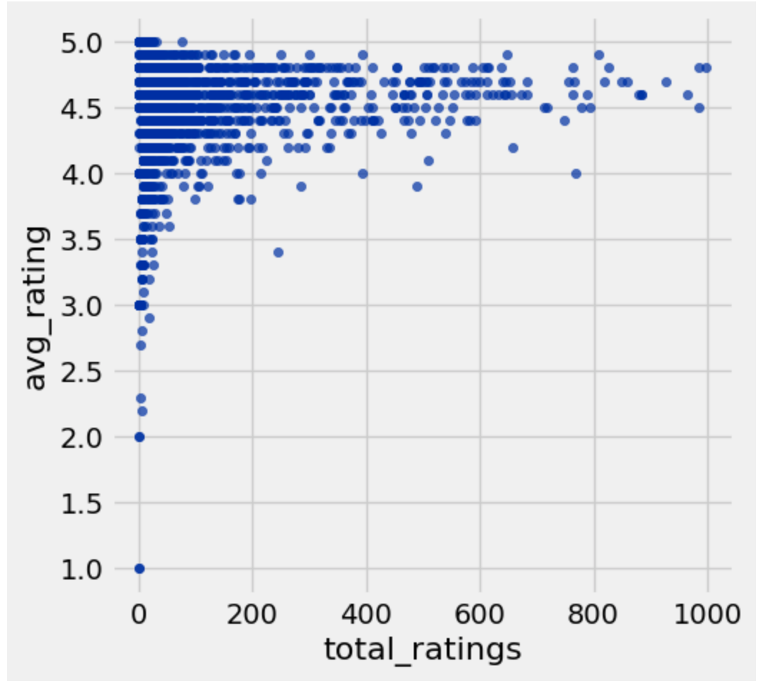
Noor Abbasi-MINI UPDATE #3
fig.3
In this scatter plot, I measured the total number of ratings to the average ratings of the entire data instead of only the top ten. Similarly to the recipes table in week 2, fig. 3, displays a higher total and average ratings from 4.4 to 4.8. I also see that at a 5.0 rating, the total number of ratings does not exceed 200. I also noticed that there is very little total ratings with people who rated a recipe less than 3.5.

Slide 19
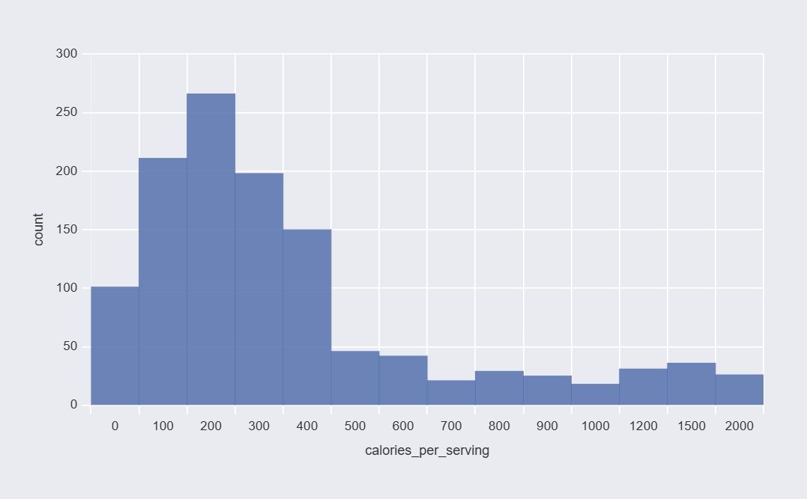
Alyssa S - Mini Update #3
Graph between Calories & Ingredients
ANALYSIS: This histogram breaks down all the recipes by calorie count, with each bar representing a calorie range and the height showing how many recipes fall in it. The tallest bars are in the 200 to 400 calorie range, which tells us that most recipes on ‘AllRecipes’ are moderate in calories and are typical everyday home cooking. The distribution has a long right tail, meaning high-calorie recipes exist but they're the minority. This connects directly to my curious question about ingredient count and cook time since we can see where most recipes sit calorically, we have a baseline for understanding what pushes a recipe above or below that 200–400 area. More ingredients and longer cook times move the recipes toward that right tail.

Slide 20
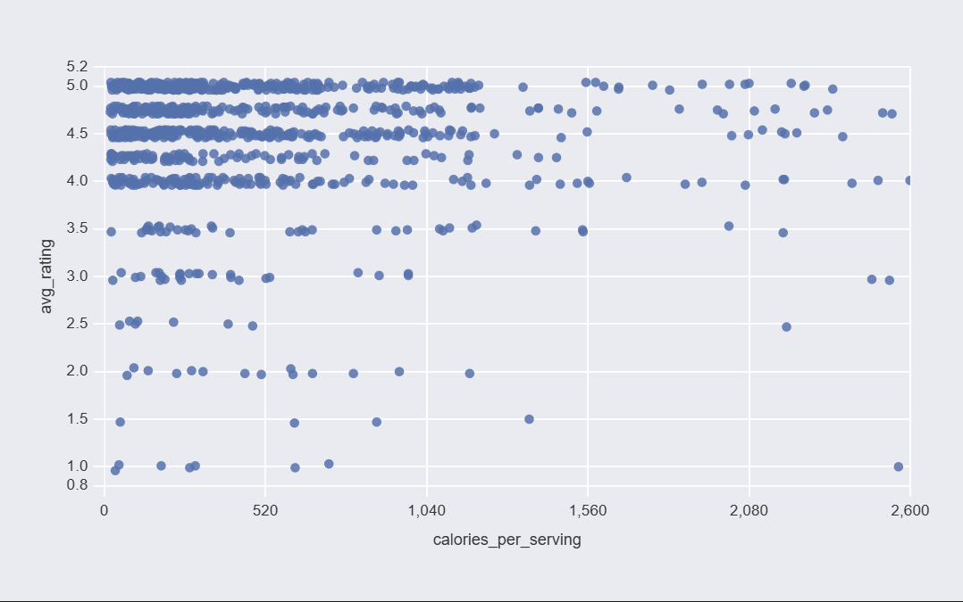
Alyssa S - Mini Update #3
Graph between Calories & Ingredients
ANALYSIS: This scatter plot shows every recipe in the dataset as a single dot, with calories per serving on the x-axis and the average rating on the y-axis. What immediately gets my attention is how dense the left side is with the vast majority of recipes cluster under 500 calories. They span the full range of ratings from 1 to 5. As calories go up past 1,000, the dots get sparse but they still reach ratings of 4 and 5. This tells us that calorie count doesn't really explain how well a recipe is rated and how people enjoy both light and heavy dishes equally. The graph answers part of my curious question by showing that high calorie recipes aren't penalized in ratings, which means popularity is driven by something other than nutrition.

Slide 21
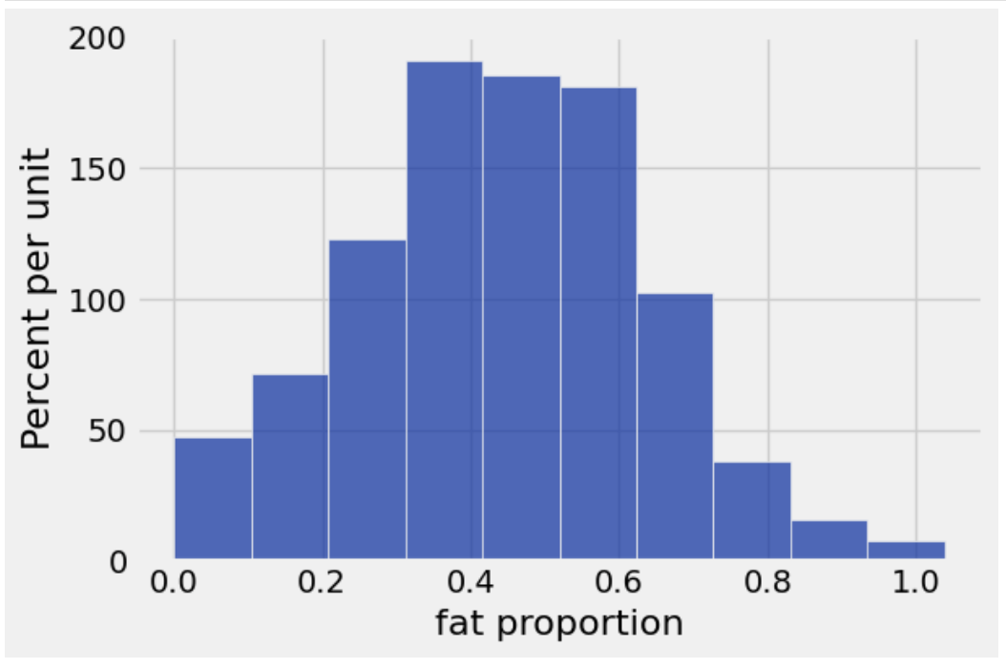
Ava G - Mini Update #3
Distribution of recipes based on fat proportion
ANALYSIS: I looked at the proportion of calories from fat the equation is (9xfat in grams)/total calories. Then, I created a histogram to demonstrate the distribution of recipes based on fat proportion, or the amount of calories in a recipe from fat. The ideal fat proportion sits somewhere around 20-30% (ideally 25-25-50 for fat protein and carbs, the three macronutrients of our diets). However, the graph shows that the majority of recipes are from 30%-50% calories from fat, which is moderately high. However, there are more low-fat recipes than there are high high fat recipes.

Slide 22
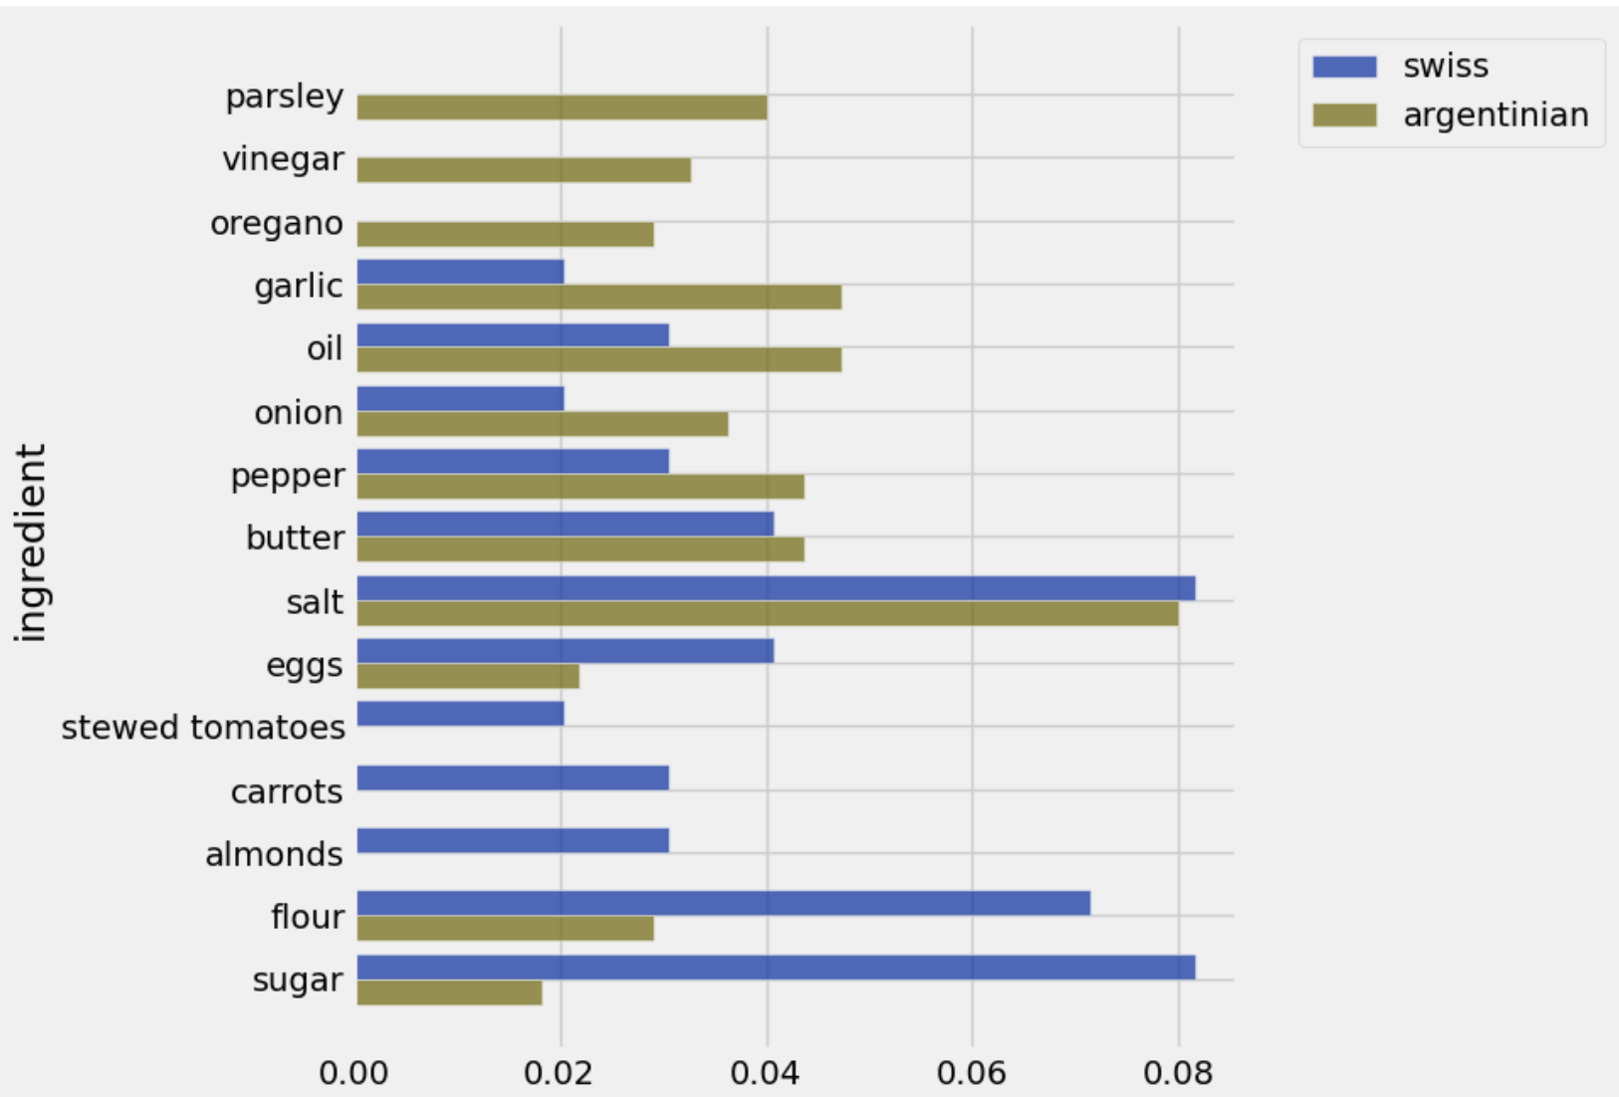
Ava G - Mini Update #3
Most common ingredients for swiss and argentinian recipes
ANALYSIS: I grouped the recipes by country and sorted them by average calories, and Swiss recipes were the highest calories at an average of 386.5, and Argentinian recipes had the lowest average calories of 292.2. I then looked at the ingredients for all argentinian and swiss recipes, and used AI to clean the ingredients lists into arrays, dropping the measurements and instructions. I kept the top ten most commonly recurring ingredients for both countries and used AI to compare the proportion of recipes that have each ingredient (because comparing counts wouldnt be helpful when the countries have different amounts of total recipes. The graph shows argentinian recipes mostly have ingredients that are low calorie like vinegar, veggies, and seaonsing. In comparison, swiss recipes have more flour and sugar, which are calorically dense. There arent many major differences, however. Salt, of course, is the top ingredient for both, because all food needs salt.

Slide 23
Country A
Country B
Ingredient 1
Ingredient 2

Slide 24
Progress:
Noor- This week, I decided to give my attention to the cuisines table. In my data analysis, I graphed the top ten most popular dishes in the cuisines table along with their countries similar to what I did in week #2 but with a different table. At first, I struggled on making the code for the graphs but as I played around with it by using my resources provided by my instructor, I was able to somewhat graph what I intended to.
Alyssa: I chose to focus on this curious question, "How does the calorie amount correlate with the cook time or ingredients list?" Both of these graphs answer this question because they show how calories connect to the number of ingredients a recipe has and how long it takes to cook, based on the actual tables. Currently, I haven't faced any problems other than JupyterHub not loading my graphs at first, and I've made good progress generating both visuals that directly answer my curious question.
Ava: This week I looked at specific ingredients from countries, as well as a bit into macro proportions. I used AI to help clean the ingredients, as well as some of the more difficult lines of code for sorting the ingredients. AI is a helpful tool to do repetitive boring tasks such as data cleaning.

Slide 25
Feedback:
Ava: After being given the go-ahead to use AI to clean the data, I cleaned up the ingredients column with AI so i could better understand the most common ingredients. Unfortunately, the other bit of feedback was that perhaps cooking method impacts preparation time (which i agree with) and I cannot implement this feedback as the data given doesn’t share how the recipes are cooked.
Noor: To create my graphs, I used a bar chart. My instructor had given me feedback to use bins but I was unable to fiure out how to incorporate that into my analysis. Also I used a bar chart rather than a histogram. Going forward, I plan to find unique ways to use different graphing techniques for my analysis. Personally, I believe that my analysis could have been more detailed and I could have added more insight to the patterns I observed this week.
Alyssa: I decided to use a histogram as given my by instructor to make it more interesting., I compared two variables using this type of graph. The graphs made sense to me when i plotted them from the previous week because i can see how they correlate with each other. I hope this week I did better with seeing the calorie/ingredient count and how those correlate with one another.

Slide 26
Week 2:MINI UPDATE #2

Slide 27
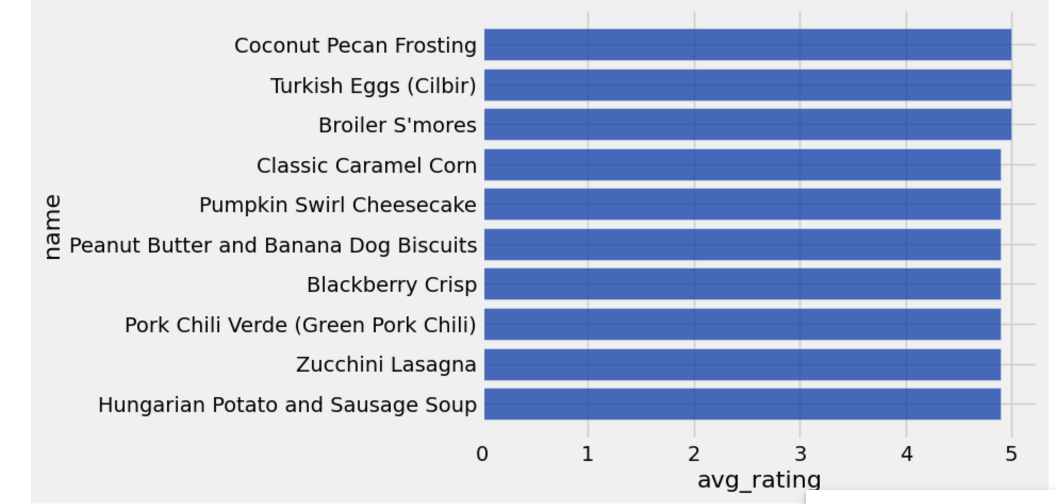
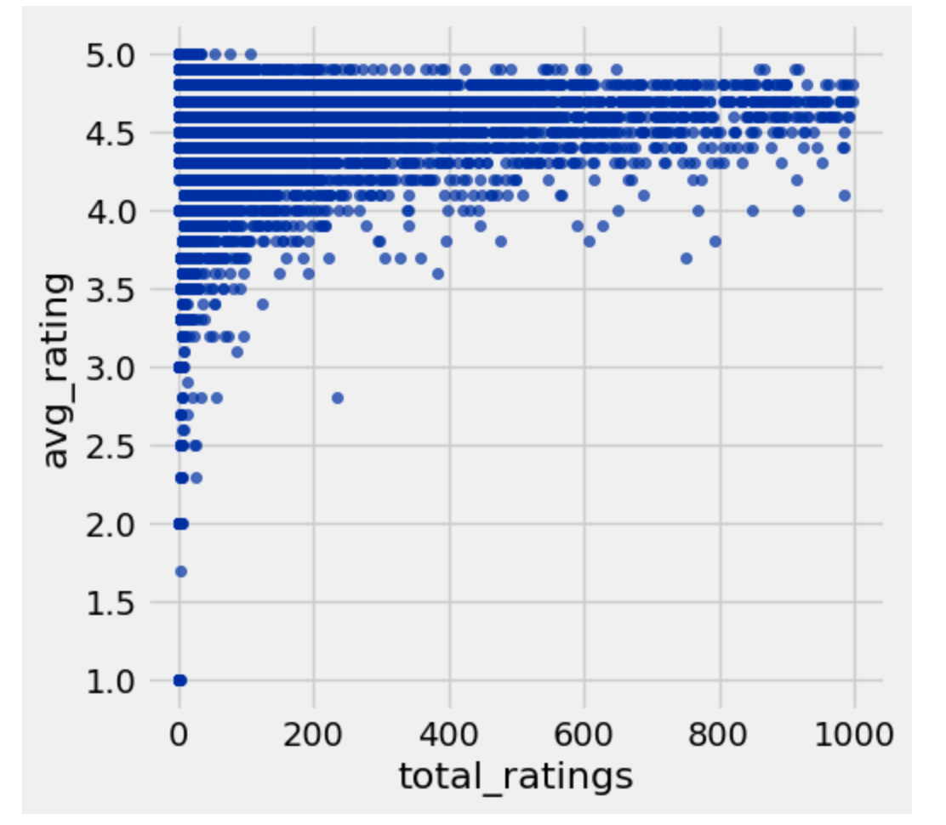
Data Analysis: Noor
fig.1
For this part of the project, I answered the curious question, ‘Which recipes are the most popular? Do they prefer to bake sweet or savory dishes? High or low calorie?’. Figure 1 demonstrates the top 10 most popular recipes in the data whereas Figure 2 presents a scatter plot showing the average rating and the number of ratings in ALL the recipes included in the data. For both of the figures, I made sure to include the highest average rating while also looking at the total number of reviewers. From looking at Figure 2, I noticed that it was less common to get a 5.0 rating. I observed how a 5.0 rating had fewer total ratings compared to 4.0-4.9 ratings. Ratings that ranged from 4.0 to 4.9 had an increased number of total ratings. I think this is because when there are more people reviewing a recipe, the average rating decreases due to the fact that more people are trying it and may not like it as much.
fig.2

Slide 28
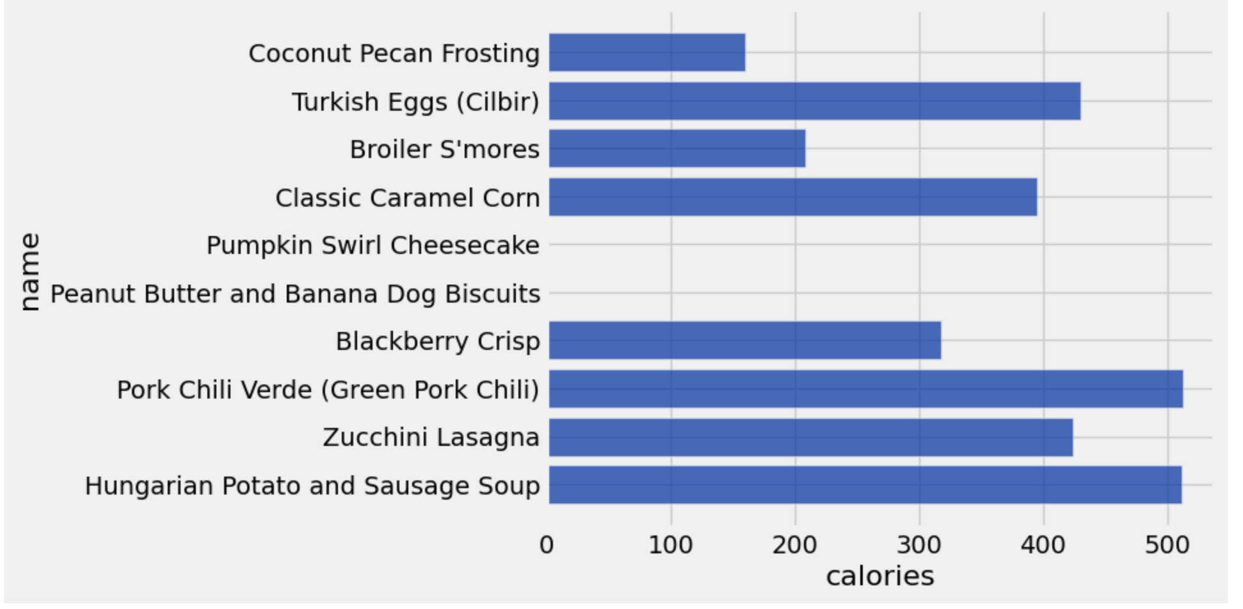
Continued Data Analysis: Noor
In the bar chart, are listed, the top 10 most popular recipes and their given calories. For the items, ‘Pumpkin Swirl Cheesecake’ and ‘Peanut Butter and Banana Dog Biscuits’, the calorie number is not listed. Looking at the other recipes, I see that most of the popular recipes have a higher number of calories and there are very few recipes that have less than 300 calories. I also notice that most of the recipes range from 300 to 500 calories. Although, you cannot tell whether the recipe is a sweet or savoury dish, you can definitely pay attention to the details in the ingredients, name, and/or images of that specific dish.
fig.3

Slide 29
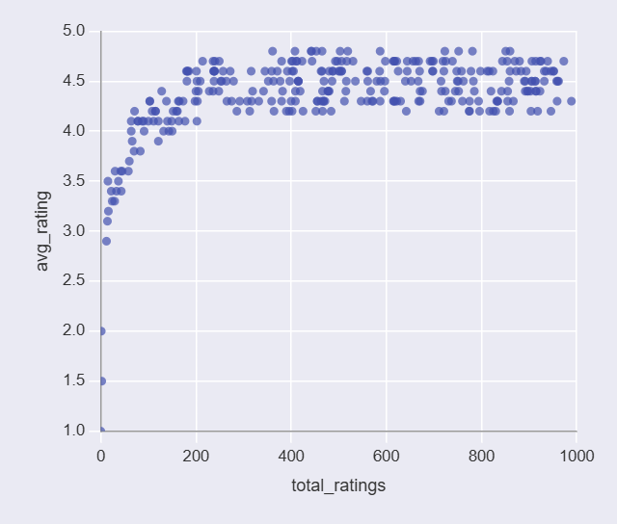
Alyssa’s Mini Update
Graph Storytelling #1
I see how high the average and total ratings are of the recipes/cuisines by the consumers and the groups of people who tried making the food. The recipes have gotten a 1.0 star rating or higher. Though it ranges solely between the 4.0 and 5.0 star rating which is a good sign. Around 1000 people rated the food after they made it. I also see that almost all of these recipes have high ratings because of certain factors including ingredients, cook preparation, feasibility of making the food, the calories, etc. These recipes that attract large numbers of reviewers tend to be well-liked as a whole. There are very few highly-rated recipes with over 800 total ratings, indicating that most popular recipes still sit in a moderate range of engagement.

Slide 30
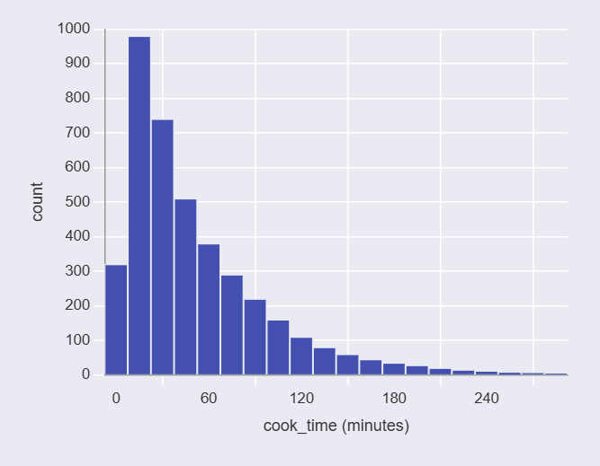
Alyssa’s Mini Update
Graph Storytelling #2
The vast majority of recipes in the dataset have a cook time under 30 minutes, with the tallest bar sitting between 15 and 30 minutes. After that, the count drops sharply and continues to fall gradually as cook times increase toward 300 minutes. This right-skewed distribution shows that most recipes on the platform are designed to be quick, with only a small number of dishes requiring lengthy cooking times like braises or slow roasts. The graph has one dominant tall bar on the left side of the chart that towers over everything else, then the bars rapidly shrink as you move right toward longer cook times. When you reach the 150 minute bar, they are hardly visible, and beyond 200 minute bar, they are almost flat against the x-axis. The shape looks like a skewed cliff dropping off to the right side, making it known that short cook times take a lead in this dataset.

Slide 31
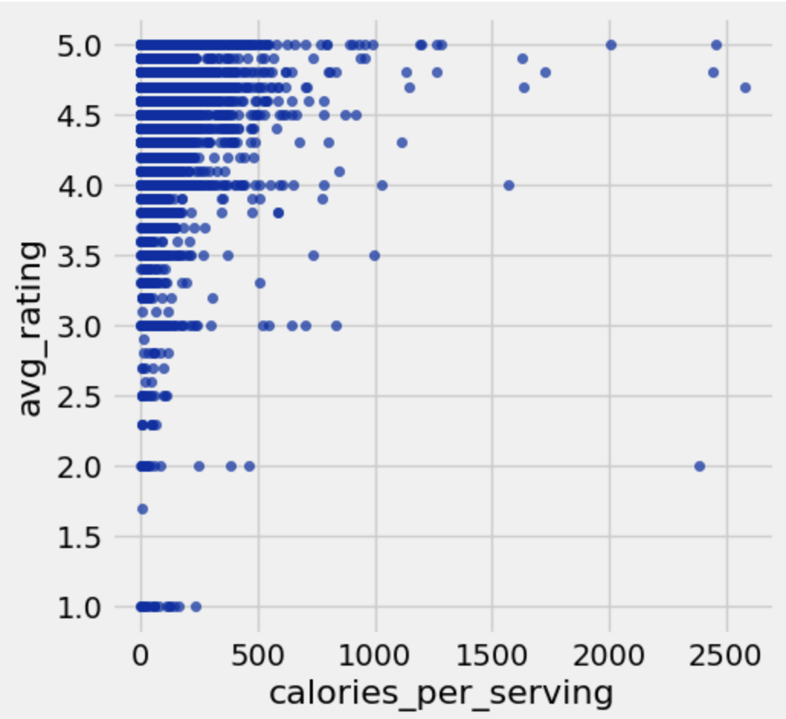
Ava’s Mini Update
Graph Storytelling #1
I was curious about whether recipes were rated higher based on a high caloric value (implying higher sugar and fat content, and a better over-all tasting recipe). However, the table didn’t have calories per serving, so I divided the calories column by the servings column, and threw out the one recipe which said an entire 5000 calorie pie was one serving. Overall, I identified a slight trend, but after using ai to find the r value of 0.02, I have determined that the strength of the correlation between these two variables as a linear relationship is SUPER weak. However, there is definitely a visual trend, so maybe the trend is a non-linear relationship. This shows that maybe higher calorie foods taste better and in turn get higher ratings.

Slide 32
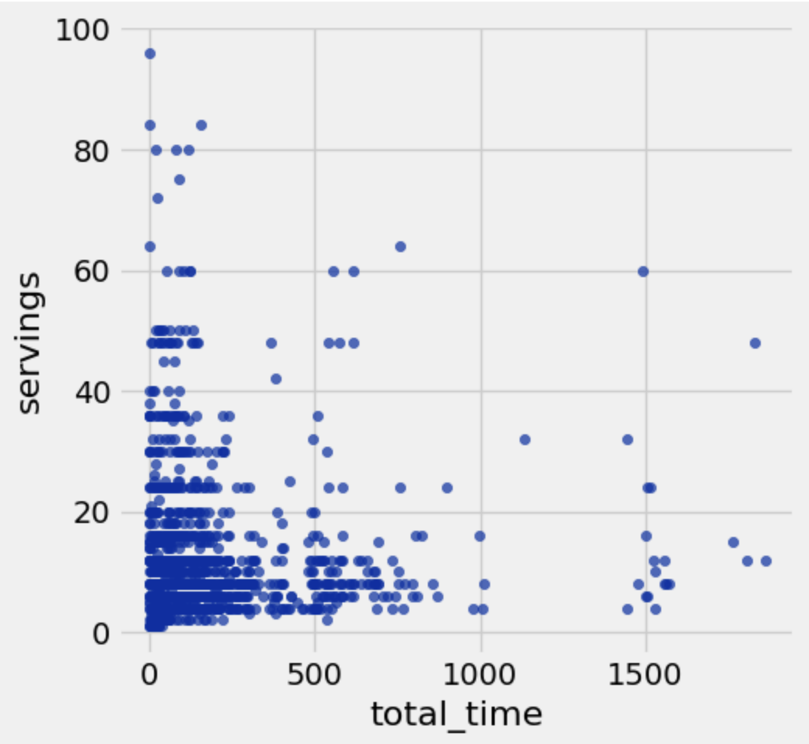
Ava’s Mini Update
Graph Storytelling #2
This scatterplot addresses the relationship between the total time (cook time and prep time) and the serving size for a recipe. I was curious to know if bigger recipes took longer to make. Honestly, I don’t see much of anything but the slight trend I do see is the opposite direction of what I expected. There are also too many data points to really see any clear trend. The story being told here is unclear.

Slide 33
Progress:
Noor: This week we have gained a deeper understanding of the data provided to us by looking at the most popular recipes, comparing them to the total ratings, and viewing their number of calories. Some obstacles I have faced was formatting the data in a way to make it look presentable and understandable and figuring out what details to include and what to leave out. Next week, I plan to incorporate the cuisines table into my data analysis!
Alyssa: I chose to focus on the curious question, “Which recipes are the most popular? Do they prefer to bake sweet or savory dishes? High or low calorie?” and, “What do the highly rated recipes have in common?” Both of my graph revolve around these because they explain which recipes are rated the most popular and what they have in common based on the actual tables. Currently, I haven’t faced any problems other than JupyterHub not loading my graphs. I’ve given a show/tell of the graphs I generated, included graphs in the Mini update that revolve around the curious questions, targeting the correct audience, and more.
Ava: (I used AI for the r-value generation.) This week we accomplished some surface level data analysis and started getting into comparing multiple variables. In the coming weeks, if its possible it could be cool to clean the “ingredients” column so its analyzable and possibly sort the countries by continent and catagorize the dishes by sweet and savory or other categories to provide further analysis. I’m not sure how to do this. It would be incredibly tedious unless I used AI. Is that a suitable usage of AI?

Slide 34
Feedback:
The feedback that our professor gave us allowed us to better understand who the audience is and what the communication goal is. To address the feedback given, the audience could be beginners who are looking for simple and easy recipes, students who need fast and convenient recipes, and/or people who have dietary restrictions. Some communication goals we may have are to change the perspective of people who may believe that it is difficult to find good, fast, and easy recipes and to encourage people to try out different recipes. The feedback was useful because it allowed us to explore a variety of options on how to improve the feedback given. Some additional suggestions that we are seeking is about the plots/graphs we created and whether our explanation was easy to follow and well-covered.

Slide 35
Week 1:MINI UPDATE #1

Slide 36
Introduction
Across the world, people face challenges related to food such as what to cook for dinner, what recipes I can make that are efficient, healthy, inexpensive, or filling. With the amount of recipes and cuisines that are out there, it gets overwhelming. When cooking, people want to know the nutrition facts, the ingredients list, the amount of time it takes, how many people it will feed, etc. A structured recipe dataset captures ingredients, cook times, cuisines, and nutritional information that offers a different opportunity to show patterns that can simplify a decision. Through this data analysis, we will be able to help people know what food recipes work best for them. They will be able to discover what kinds of recipe work for them that are (for example) more efficient and inexpensive.

Slide 37
MINI UPDATE #1- DATA PROFILE
The all_recipes dataset has 16 columns and 14,426 rows. The cuisines dataset has 17 columns and 2,218 rows.
all_recipes:
Column Name | Has missing value? | Data Type(Discrete or numeric or free text) | Useful? | Need cleaning or processing?
name | no | Free text | yes | no
url | no | Free text | yes | no
author | no | Free text | no | no
date_published | no | date/time | no | no
ingredients | no | Free text | yes | no
calories | yes | numeric | yes | no
fat | yes | numeric | yes | no
carbs | yes | numeric | yes | no

Slide 38
MINI UPDATE #1- DATA PROFILE CONTINUED
all_recipes:
Column Name | Has missing value? | Data Type(Discrete or numeric or free text) | Useful? | Need cleaning or processing?
protein | yes | numeric | yes | no
avg_rating | yes | numeric | yes | no
total_ratings | yes | numeric | yes | no
reviews | yes | numeric | yes | no
prep_time | no | numeric | yes | no
cook_time | no | numeric | yes | no
total_time | no | numeric | yes | no
servings | YES | discrete | yes | no

Slide 39
MINI UPDATE #1- DATA PROFILE CONTINUED
cuisines:
Column Name | Has missing value? | Data Type(Discrete or numeric or free text) | Useful? | Need cleaning or processing?
name | no | Free text | yes | no
country | no | Free text | yes | no
url | no | Free text | yes | no
author | no | Free text | no | no
date_published | no | date/time | no | no
ingredients | no | Free text | yes | no
calories | yes | numeric | yes | no
fat | yes | numeric | yes | no
carbs | yes | numeric | yes | no

Slide 40
MINI UPDATE #1- DATA PROFILE CONTINUED
cuisines:
Column Name | Has missing value? | Data Type(Discrete or numeric or free text) | Useful? | Need cleaning or processing?
protein | yes | numeric | yes | no
avg_rating | yes | numeric | yes | no
total_ratings | yes | numeric | yes | no
reviews | yes | numeric | yes | no
prep_time | no | numeric | yes | no
cook_time | no | numeric | yes | no
total_time | no | numeric | yes | no
servings | yes | Discrete | yes | no

Slide 41
Curious Questions - all_recipes & cuisines files
Which recipes are the most popular? Do they prefer to bake sweet or savory dishes? High or low calorie?
Does it cost a lot of money to buy these ingredients for the recipes? Do people have the recipes just lying in their homes?
What is the average cook time across all of the recipes from the spreadsheets? What is the distribution of cooking times?
What are the most common ingredients in the recipes? Are these ingredients high or low calorie (fat, protein, etc) and cost?
Can we find healthy alternatives in making these recipes by their ingredients?
How does the calorie amount correlate with the cook time or ingredients list?
Can we see what kind of recipes they are by just viewing their ingredients list?
What aspects of a recipe allow people to know whether it is highly rated or not?
What do the highly rated recipes have in common?
How does calorie amount correlate with ingredients cost?

Slide 42
Audience & Communication Goal
Audience: Home cooks, meal planners, families, and food enthusiasts who like to improve on their cooking skills or would want to make smarter decisions while their in the kitchen. We will narrow it down to families and food enthusiast, but primarily families.
Communication Goals:
To provide a variety of recipes so chefs can explore different cuisines
To find better ways to cook (cheaper, healthier macros, lower calories, yummier, faster/ more efficient)
To discover new recipes based on recipes they already like

